Slide 1


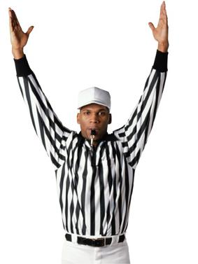
Team 4 NFL Stats Magic Project Review
Neal Rosenberger, Adrian Schmiltz , Tristan Ernhart, Derek Johnson
Developers
November 2017

Slide 2





Agenda
Description and Motivations
Results
Team Effort
Challenges
Planned Improvements

Slide 3
Why Build a new NFL Site?

Slide 4



Unlike sites with a clutter of advertising, related links, and too many stats, we have created a site with an NFL heat map, stats on demand for your team
Strategize
Pick a team and see top stats immediately
Analyze
Show Love
A quick way to understand NFL Stats on a single page
Show love for you team and see map of fellow fans
Our experts designed stats and info immediately displayed to help understand team strength

Slide 5
Results
Strong, single page site that pulls direct info from current week stats so that the user can help judge their team
Data is shown in graphical format to pick a team quickly
A user can select to give a team “Love” to their team.
The “Love” is plotted and mapped for all users

Slide 6
Demo

Slide 7
Team Efforts
Heat Map Creation
HTML Setup
Adrian
API Research
Styling
Neal
Java Script
jQuery
Tristan
Derek
Team List
API Call

Slide 8
Challenges
Issue
Description
Starting from a blank Canvas rather than requirements or “broken” cod to fix. Neal thought of a NFL betting site, but the APIs for betting are expensive.
Creating Art
API data that was good tended to be very hard to work with due to layers and structuring.
Anything related to betting and odds was expensive.
API
We learned how to pull before editing and then pushing in turn to get a final and fully review. Editing a doc that was not current led to file integrity issues
Git Hub

Slide 9
Planned Improvements
Deliverables | Description
News Feed | Keeping with single page theme, a quick list of top articles on team to help make decisions. The article would be in bottom right corner and be headlines only.
Stub hub | This would monetize the site without ads. Stub hub would require a PayPAl setup, but the link to our site would generate funds as we could get 50% of the profits for ticket buying.
Matchup | Given a user picking a team, the next opponent will also show and love between the 2 teams can be mapped

Slide 10
Thank you!

